Slide 1
GRAPH DATA STRUCTURE

Slide 2
GRAPH
Introduction to Graph Data Structure.
Depth First Traversal In Graph
Breadth First Traversal in Graph

Slide 3
Graph Data Structure
A Graph is a non-linear data structure consisting of nodes and edges.
The nodes are sometimes also referred to as vertices and the edges are lines or arcs that connect any two nodes in the graph.
More formally a Graph can be defined as:
▫ A Graph consists of a finite set of vertices(or nodes) and set of Edges which connect a pair of nodes.

Slide 4
APPLICATION OF GRAPH
Graphs are used to represent many real-life applications:
Graphs are used to represent networks. The networks may include paths in a city or telephone network or circuit network.
Graphs are also used in social networks like linkedIn, Facebook. For example, in Facebook, each person is represented with a vertex(or node). Each node is a structure and contains information like person id, name, gender and locale.
Graph theory is also used to study molecules in chemistry and physics.
In chemistry a graph makes a natural model for a molecule, where vertices represent atoms and edges bonds.

Slide 5
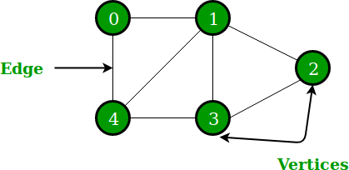
In the above Graph, the
set of vertices V = {0,1,2,3,4} and
the set of edges E = {0-1, 1-2, 2-3, 3-4, 0-4, 1-4, 1-3}.

Slide 6
Directed vs. undirected graphs
When the edges in a graph have no direction, the graph is called undirected
A
VERTICES V={ A,B,C,D }
EDGES E= { A-B, A-D, A-C, B-C,}
B
C
D

Slide 7
Directed vs. undirected graphs
When the edges in a graph have a direction, the graph is called directed (or digraph)
If the graph Is directed, the order of the vertices in each edge is important !!
1
3
11
5
7
9
E = {(1,3) (3,1) (5,9) (9,11) (5,7) (11,1) (7,7)}

Slide 8
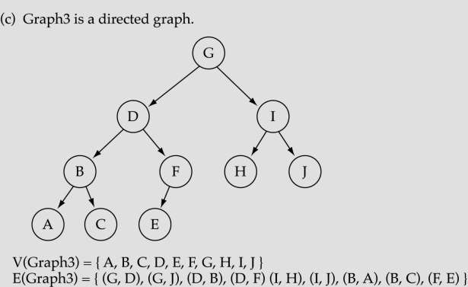
Trees vs graphs
Trees are special cases of graphs!!
A
B
C
D
E
F
G
H
I

Slide 9
Graph terminology
Adjacent nodes or neighbours For every edge, e = (u, v) that connects nodes u and v, the nodes u and v are the end-points and are said to be the adjacent nodes or neighbours.
Degree of a node Degree of a node u, deg(u), is the total number of edges containing the node u. If deg(u) = 0, it means that u does not belong to any edge and such a node is known as an isolated node.
Regular graph It is a graph where each vertex has the same number of neighbours. That is, every node has the same degree. A regular graph with vertices of degree k is called a k–regular graph or a regular graph of degree k.
Path A path P written as P = {v0, v1, v2, ..., vn), of length n from a node u to v is defined as a sequence of (n+1) nodes. Here, u = v0, v = vn and vi–1 is adjacent to vi for i = 1, 2, 3,
..., n.
Connected graph A graph is said to be connected if for any two vertices (u, v) in V there is a
path from u to v. That is to say that there are no isolated nodes in a connected graph. A connected
graph that does not have any cycle is called a tree.

Slide 10
Graph terminology
What is the number of edges in a complete directed graph with N vertices?
N * (N-1)
A graph G is said to be complete if all its nodes are fully connected. That is, there is a path from one node to every other node in the graph. A complete graph has n(n–1)/2 edges, where n is the number of nodes in G.

Slide 11
Graph terminology
Labelled graph or weighted graph A graph is said to be labelled if every edge in the graph is assigned some data. In a weighted graph, the edges of the graph are assigned some weight or length. The weight of an edge denoted by w(e) is a positive value which indicates the cost of traversing the edge.
Delhi
300
600
300
250
600
Ahmedbad
Kolkata
Bhopal
200
Raipur
1000
700
1000
700
1200
Mumbai
Chennai

Slide 12
REPRESENTATION OF GRAPH
There are three common ways of storing graphs in the computer’s memory. They are:
Sequential representation by using an adjacency matrix.
Linked representation by using an adjacency list that stores the neighbours of a node using a linked list.
Adjacency multi-list which is an extension of linked representation.
we will discuss both these schemes in detail

Slide 13
ADJACENCY MATRIX REPRESENTATION
An adjacency matrix is used to represent which nodes are adjacent to one another.
By definition,two nodes are said to be adjacent if there is an edge connecting them.
In a directed graph G, if node v is adjacent to node u, then there is definitely an edge from u to v. That is, if v is adjacent to u, we can get from u to v by traversing one edge. For any graph G having n nodes, the adjacency matrix will have the dimension of n n.

Slide 14
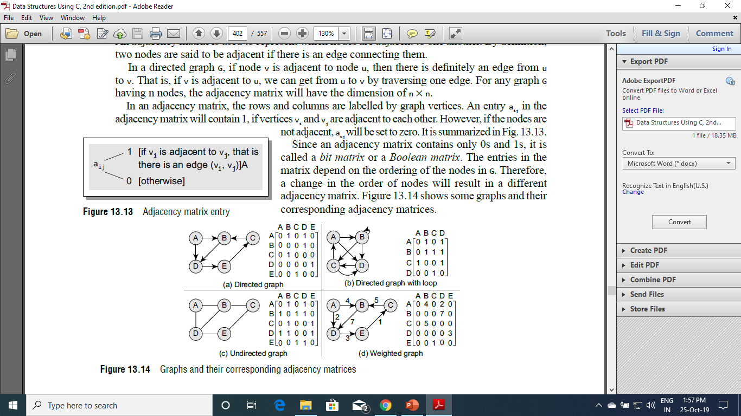
ADJACENCY MATRIX REPRESENTATION
In an adjacency matrix, the rows and columns are labelled by graph vertices.
An entry aij in the adjacency matrix will contain 1, if vertices vi and vj are adjacent to each other. However, if the nodes are not adjacent, aij will be set to zero

Slide 15
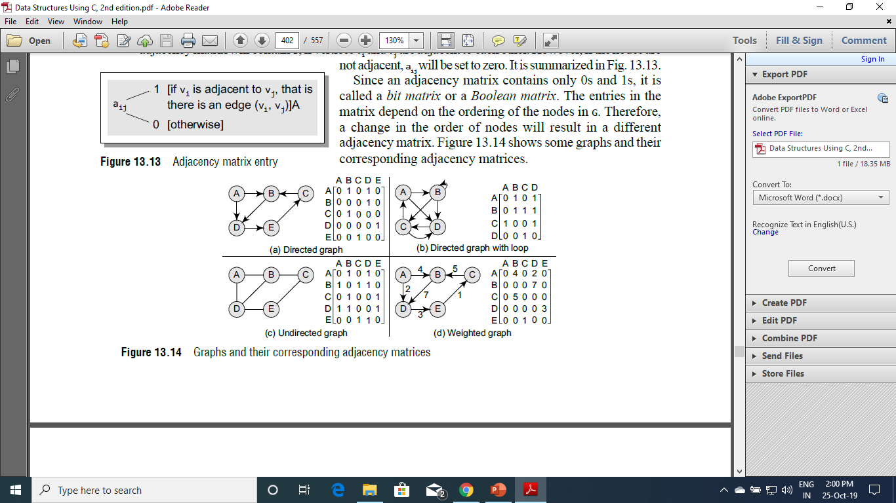
ADJACENCY MATRIX REPRESENTATION

Slide 16
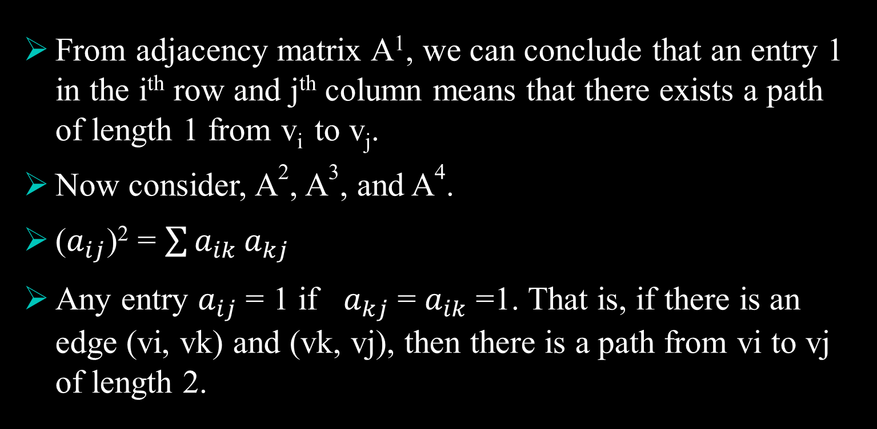
POWER OF ADJACENCY MATRIX (PATH MATRIX)
From adjacency matrix A¹, we can conclude that an entry 1 in the i^{th} row and j^{th} column means that there exists a path of length 1 from v_{i} to v_{j}.
Now consider, A², A³, and A⁴.
($a_{ij}$)² = $\sum{a_{ik}}a_{kj}$
Any entry $a_{ij}$= 1 if $a_{kj}$= $a_{ik}$=1. That is, if there is an edge (vi, vk) and (vk, vj), then there is a path from vi to vj of length 2.

Slide 17
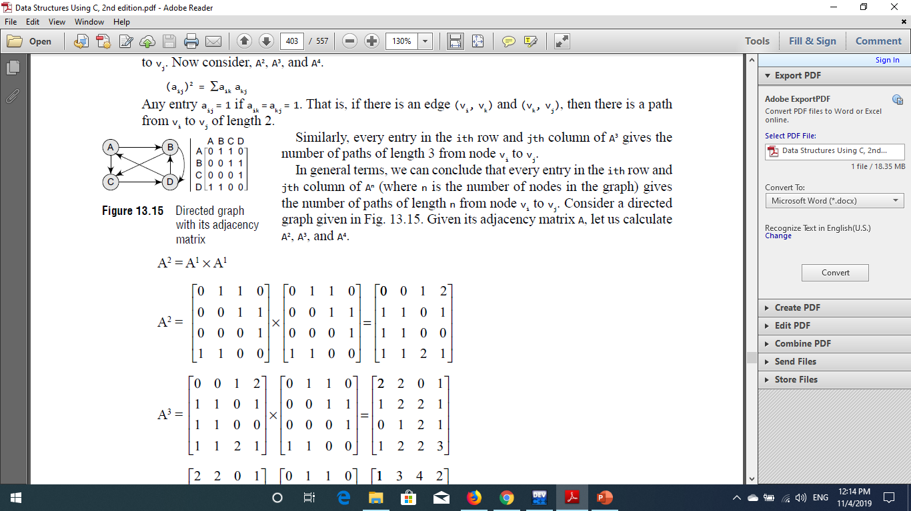
PATH MATRIX
Similarly, every entry in the ith row and jth column of A³ gives the number of paths of length 3 from node vi to vj.
In general terms, we can conclude that every entry in the ith row and jth column of An (where n is the number of nodes in the graph) gives the number of paths of length n from node vi to vj. Consider a directed graph.

Slide 18
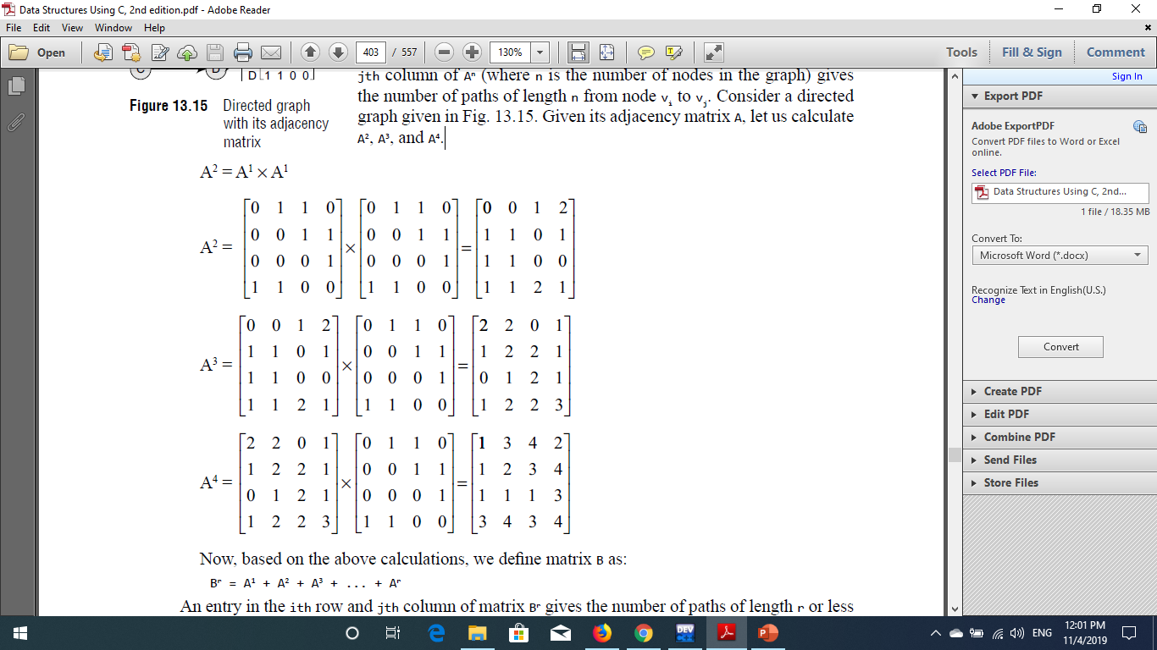
PATH MATRIX
Given its adjacency matrix A, let us calculate A², A³, and A⁴.

Slide 19
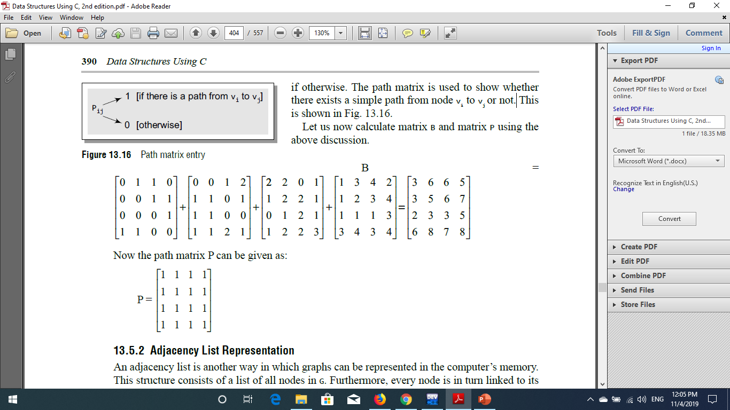
PATH MATRIX
Now, based on the above calculations, we define matrix B as:
B^{r} = A¹ + A² + A³ + ... + A^{r}
An entry in the ith row and jth column of matrix Br gives the number of paths of length r or less than r from vertex vi to vj. The main goal to define matrix B is to obtain the path matrix P.
The path matrix P can be calculated from B by setting an entry Pij = 1, if Bij is non-zero and Pij = 0, if otherwise.
The path matrix is used to show whether there exists a simple path from node vi to vj or not.

Slide 20
PATH MATRIX

Slide 21
ADJACENCY LIST REPRESENTATION
An adjacency list is another way in which graphs can be represented in the computer’s memory.
This structure consists of a list of all nodes in G. Furthermore, every node is in turn linked to its own list that contains the names of all other nodes that are adjacent to it.
The key advantages of using an adjacency list are:
It is easy to follow and clearly shows the adjacent nodes of a particular node.
It is often used for storing graphs that have a small-to-moderate number of edges.

Slide 22
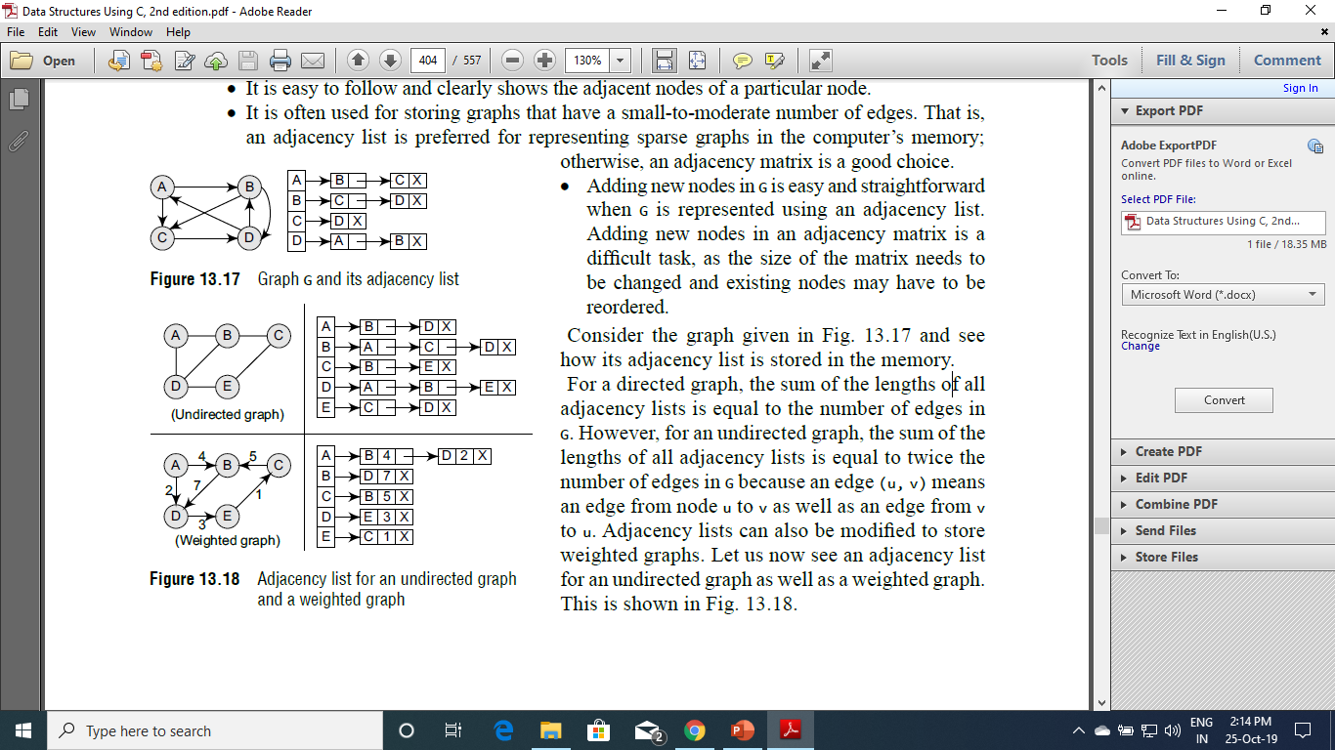
ADJACENCY LIST REPRESENTATION
Adding new nodes in G is easy and straightforward when G is represented using an adjacency list. Adding new nodes in an adjacency matrix is a difficult task, as the size of the matrix needs to be changed and existing nodes may have to be reordered.

Slide 23
ADJACENCY LIST REPRESENTATION

Slide 24
Graph Traversal Algorithms
Graph traversal means visiting all the nodes of the graph.
We want to visit every vertex and every edge exactly once in some well-defined order.
There are two primary traversal algorithms:
Breadth-First Search (BFS)
Depth-First Search (DFS).

Slide 25
DFS/BFS Search Algorithm
SEARCH(Node n):
Visit n.
Put n's children on a list (Stack or Queue).
For each child c in list: SEARCH(c)
If we use a Stack and recursive, we get DFS
If we use a Queue and iterative, we get BFS

Slide 26
BFS-Breadth First Search
Idea: Visit all children before first grandchild.
Visiting order: Visit a vertex, then visit all of its neighbors, then visit all of the neighbors of its neighbors, . . .
BFS is that a BFS is best used at finding the shortest paths in a given Graph
Needs flags or someway to preventing infinite loops:
Weakness

Slide 27
BFS Algorithm
Step 1: SET STATUS = 1 (ready state) for each node in G
Step 2: Enqueue the starting node A and set its STATUS = 2
(waiting state)
Step 3: Repeat Steps 4 and 5 until QUEUE is empty
Step 4: Dequeue a node N. Process it and set its STATUS = 3
(processed state).
Step 5: Enqueue all the neighbors of N that are in the ready state
(whose STATUS = 1) and set their STATUS = 2 (waiting state)
[END OF LOOP]
Step 6: EXIT

Slide 28
BFS Algorithm
We start examining the node A and then all the neighbours of A are examined.
In the next step, we examine the neighbours of neighbours of A, so on and so forth.
This means that we need to track the neighbours of the node and guarantee that every node in the graph is processed and no node is processed more than once.
This is accomplished by using a QUEUE that will hold the nodes that are waiting for further processing and a variable STATUS to represent the current state of the node.

Slide 29
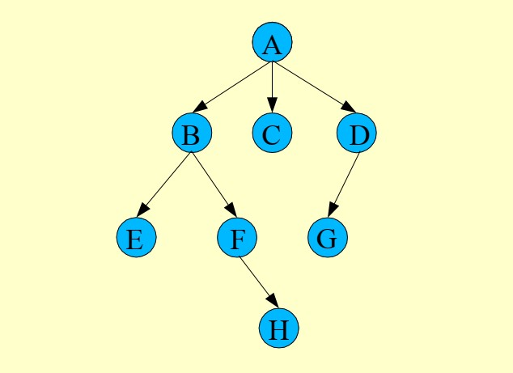
Example : BFS

Slide 30
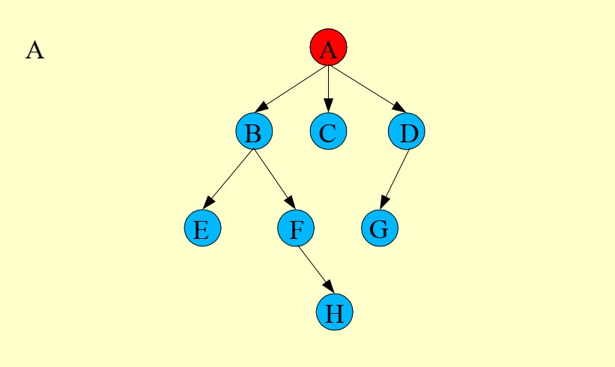
Cont’d…

Slide 31
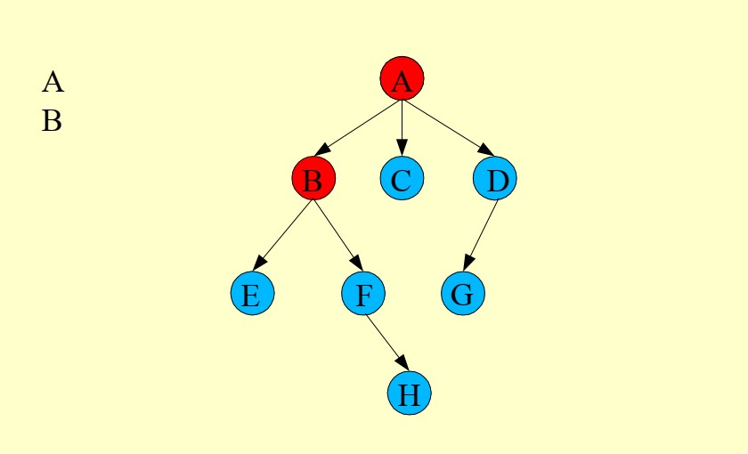
Cont’d…

Slide 32
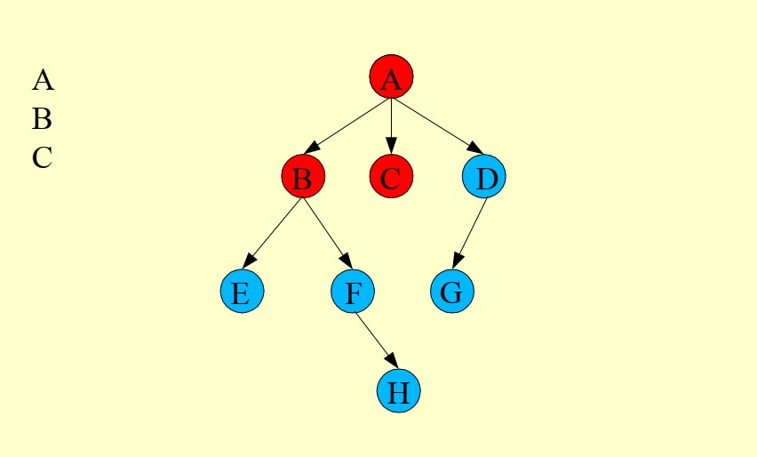
Cont’d…

Slide 33
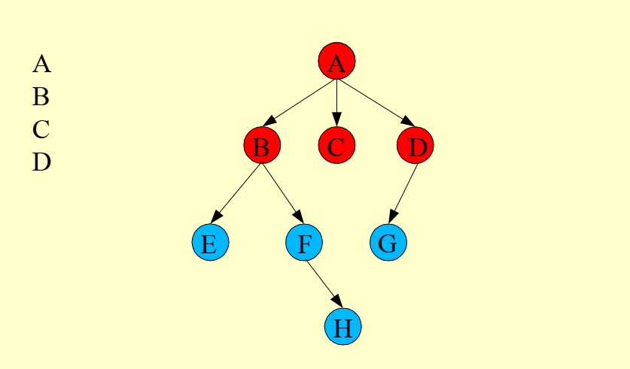
Cont’d…

Slide 34
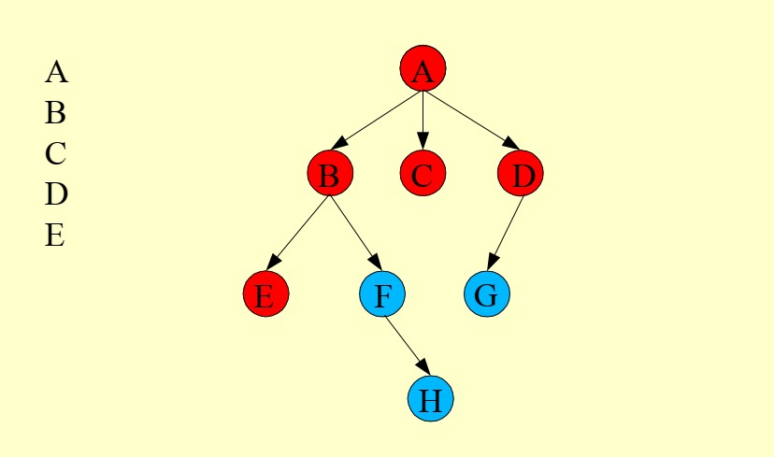
Cont’d…

Slide 35
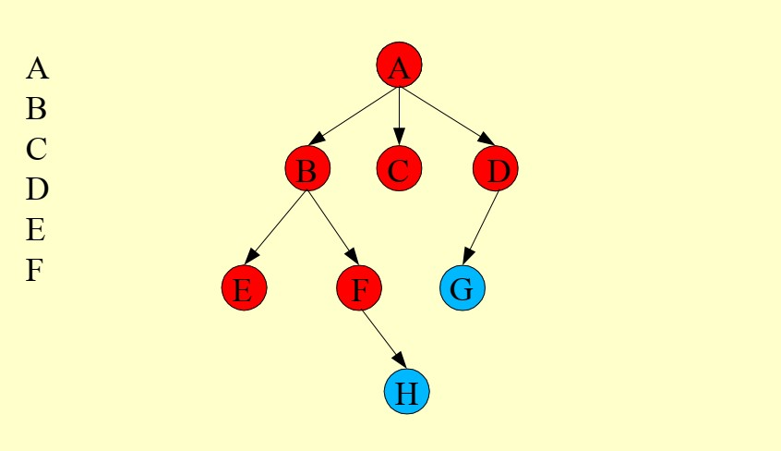
Cont’d…

Slide 36
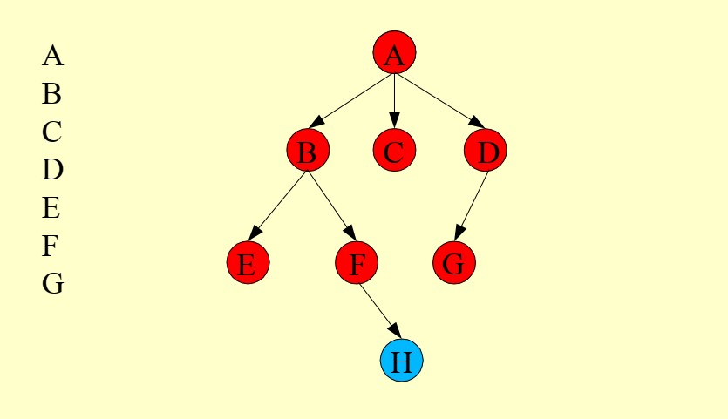
Cont’d…

Slide 37
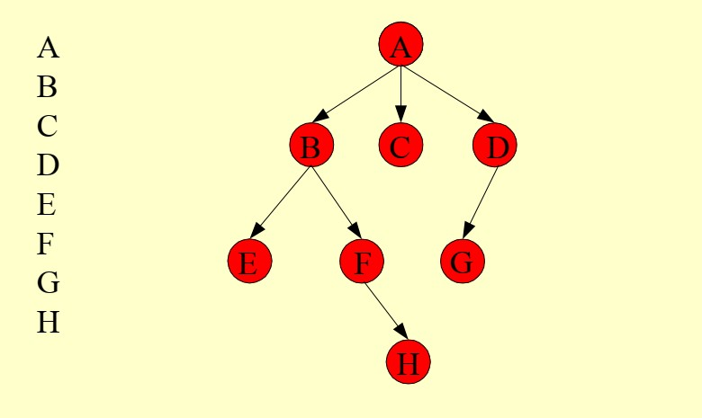
Cont’d…

Slide 38
Features of BFS Algorithm
Space complexity In the breadth-first search algorithm, all the nodes at a particular level must be saved until their child nodes in the next level have been generated. The space complexity is therefore proportional to the number of nodes at the deepest level of the graph
Time complexity In the worst case, breadth-first search has to traverse through all paths to all possible nodes, thus the time complexity of this algorithm asymptotically approaches O(bd).
Completeness Breadth-first search is said to be a complete algorithm because if there is a solution, breadth-first search will find it regardless of the kind of graph.
Optimality Breadth-first search is optimal for a graph that has edges of equal length, since it always returns the result with the fewest edges between the start node and the goal node.

Slide 39
Applications of BFS Algorithm
Breadth-first search can be used to solve many problems such as:
Finding all connected components in a graph G.
Finding all nodes within an individual connected component.
Finding the shortest path between two nodes, u and v, of an unweighted graph.
Finding the shortest path between two nodes, u and v, of a weighted graph.

Slide 40
DFS-Depth First Search
The depth-first search algorithm progresses by expanding the starting node of G and then going deeper and deeper until the goal node is found, or until a node that has no children is encountered.
When a dead-end is reached, the algorithm backtracks, returning to the most recent node that has not been completely explored.
In this algorithm, edges that lead to a new vertex are called discovery edges and edges that lead to an already visited vertex are called back edges.

Slide 41
DFS ALGORITHM
Step 1: SET STATUS = 1 (ready state) for each node in G
Step 2: Push the starting node A on the stack and set its STATUS = 2 (waiting state)
Step 3: Repeat Steps 4 and 5 until STACK is empty
Step 4: Pop the top node N. Process it and set its STATUS = 3 (processed state)
Step 5: Push on the stack all the neighbours of N that are in the ready state (whose STATUS = 1) and set their STATUS = 2 (waiting state)
[END OF LOOP]
Step 6: EXIT

Slide 42
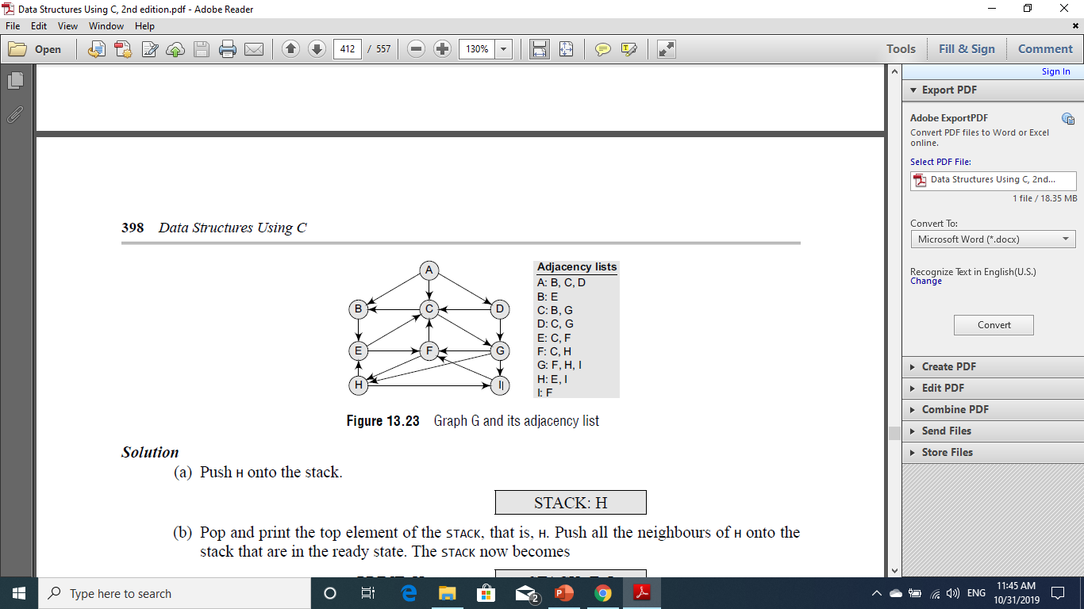
DFS EXAMPLE
Consider the graph G given.
Suppose we want to print all the nodes that can be reached from the
node H (including H itself).

Slide 43
DFS EXAMPLE
Push H onto the stack.
STACK : H

Slide 44
DFS EXAMPLE
STEP 2:
Pop and print the top element of the STACK, that is, H.
Push all the neighbors of H onto the stack that are in the ready state. The STACK now becomes.
STACK : I
STACK :
PRINT : H
STACK : E

Slide 45
DFS EXAMPLE
STEP 3:
Pop and print the top element of the STACK, that is, I.
Push all the neighbors of I onto the stack that are in the ready state. The STACK now becomes.
STACK : F
PRINT : I
STACK : E

Slide 46
DFS EXAMPLE
STEP 4:
Pop and print the top element of the STACK, that is, F.
Push all the neighbors of F onto the stack that are in the ready state. Note F has two neighbors, C and H. But only C will be added, as H is not in the ready state. The STACK now becomes.
STACK : C
PRINT : F
STACK : E

Slide 47
DFS EXAMPLE
STEP 5:
Pop and print the top element of the STACK, that is, C.
Push all the neighbors of C onto the stack that are in the ready state. The STACK now becomes.
STACK : G
STACK : B
PRINT : C
STACK : E

Slide 48
DFS EXAMPLE
STEP 6:
Pop and print the top element of the STACK, that is, G.
Push all the neighbors of G onto the stack that are in the ready state. Since there are no neighbours of G that are in the ready state, no push operation is performed. The STACK now becomes.
STACK : B
PRINT : G
STACK : E

Slide 49
DFS EXAMPLE
STEP 7:
Pop and print the top element of the STACK, that is, B.
Push all the neighbors of B onto the stack that are in the ready state. Since there are no neighbours of G that are in the ready state, no push operation is performed. The STACK now becomes.
PRINT : B
STACK : E

Slide 50
DFS EXAMPLE
STEP 8:
Pop and print the top element of the STACK, that is, E.
Push all the neighbors of E onto the stack that are in the ready state. Since there are no neighbours of G that are in the ready state, no push operation is performed. The STACK now becomes Empty.
PRINT : E
STACK : Empty

Slide 51
DFS EXAMPLE
Since the STACK is now empty, the depth-first search of G starting at node H is complete and the nodes which were printed are:
PRINT : H ,I , F, C, G, B ,E

Slide 52
Features of DFS Algorithm
Space complexity The space complexity of a depth-first search is lower than that of a breadth-first search.
Time complexity The time complexity of a depth-first search is proportional to the number of vertices plus the number of edges in the graphs that are traversed. The time complexity can be given as (O(|V| + |E|)).
Completeness Depth-first search is said to be a complete algorithm. If there is a solution, depth-first search will find it regardless of the kind of graph.

Slide 53
Applications of DFS Algorithm
Depth-first search is useful for:
Finding a path between two specified nodes, u and v, of an unweighted graph.
Finding a path between two specified nodes, u and v, of a weighted graph.
Finding whether a graph is connected or not.
Computing the spanning tree of a connected graph.

Slide 54
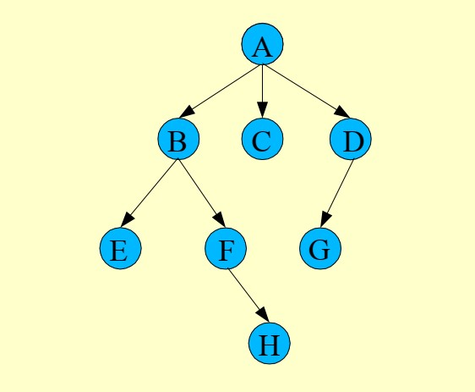
Example:DFS

Slide 55
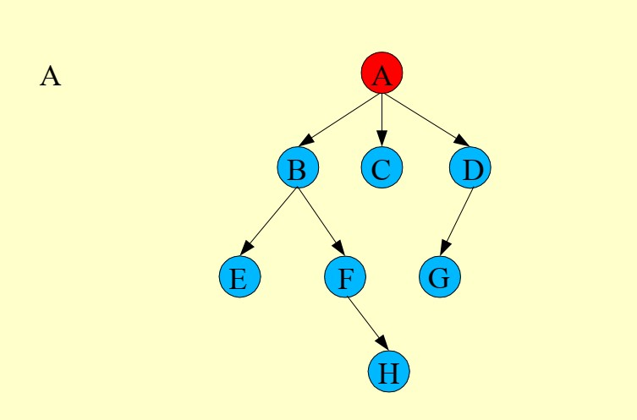
Cont’d…

Slide 56
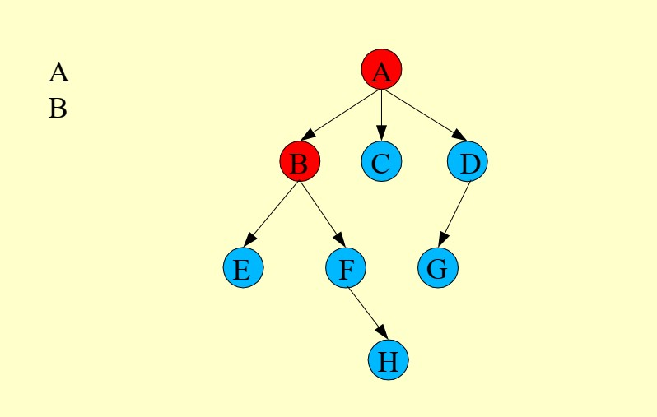
Cont’d…

Slide 57
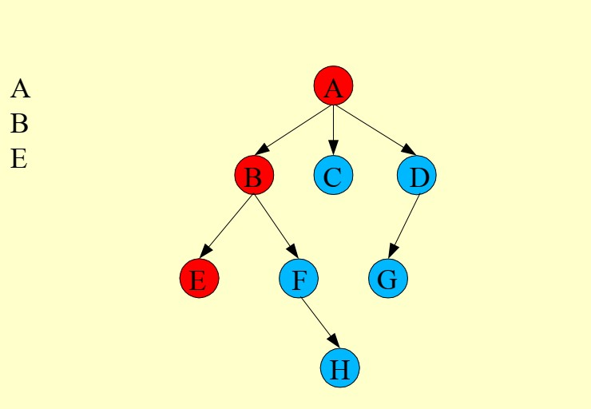
Cont’d…

Slide 58
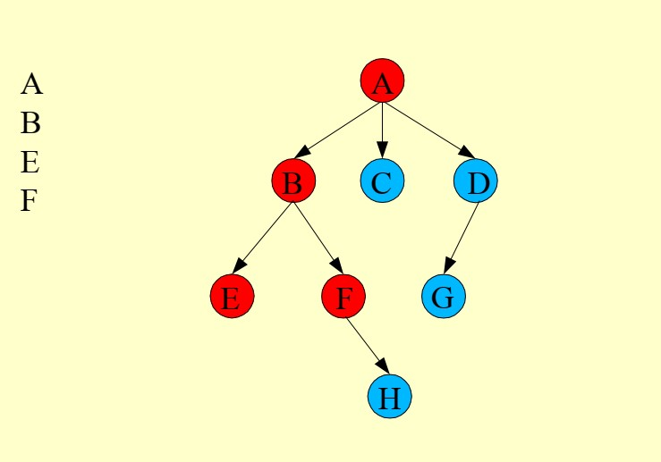
Cont’d…

Slide 59
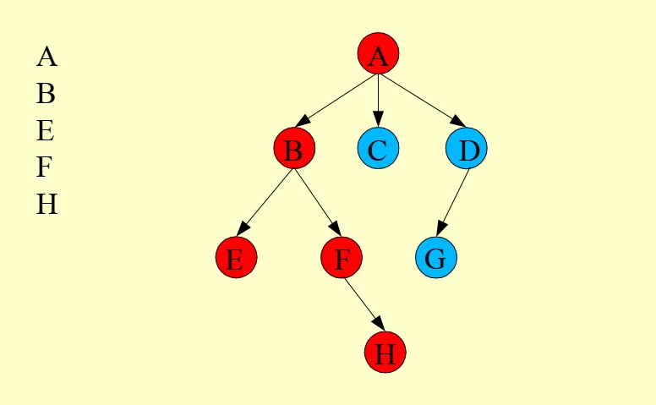
Cont’d…

Slide 60
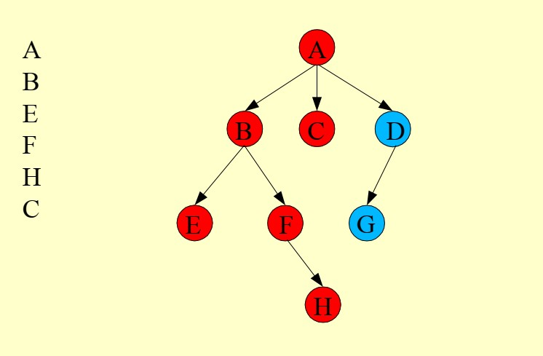
Cont’d…

Slide 61
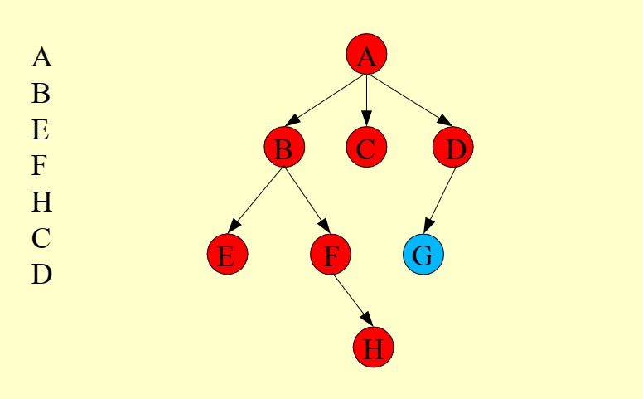
Cont’d…

Slide 62
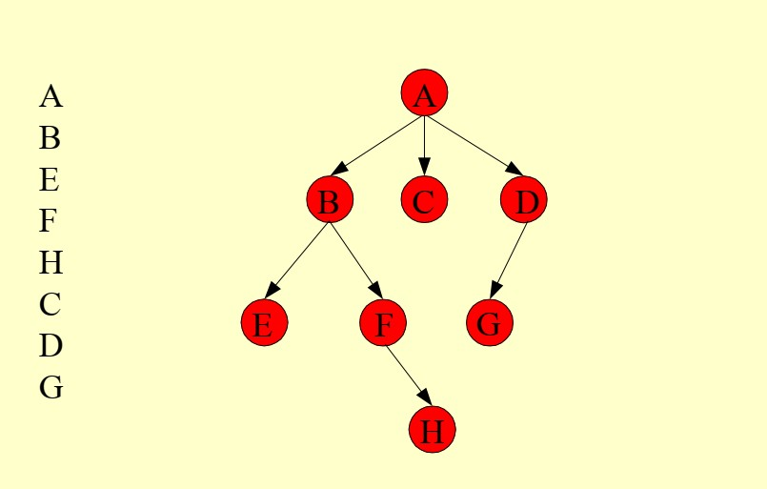
Cont’d…

Slide 63
CONCLUSION
A Graph is a non-linear data structure, which consists of vertices(or nodes) connected by edges(or arcs) where edges may be directed or undirected.
Graph is represented by two important ways: Adjacency List and Adjacency Matrix.
Graph traversal is a process of checking or updating each vertex in a graph.
Graph traversal means visiting each and exactly one node.
There are two graph traversals: Breadth first Search: Visits the neighbor vertices before visiting the child vertices and Depth First Search:is used for traversing a finite graph.

